Slide 1
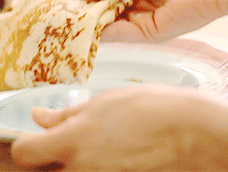
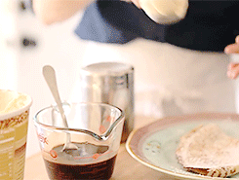
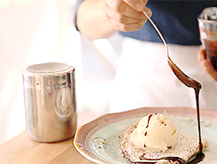
The History of Crêpes

Slide 2
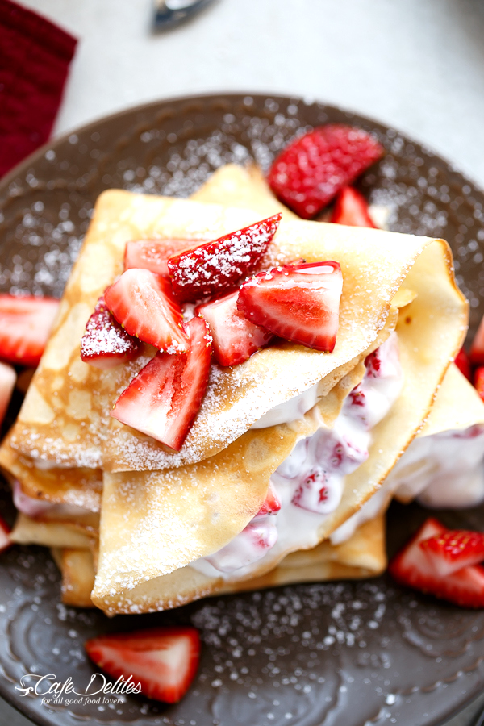
What the heck are crêpes???
A crêpe is a type of very thin pancake usually made from wheat flour. In France the pancake is known as a crêpe, spelled with a character known as the circumflex or ˆ over the first "e." The word comes from the Latin term crispus, which explains the flat, almost crisp texture. The crêpe actually originated in Brittany, in the northwest corner of France, where they still make sweet crêpes or galettes, which are filled with meats and cheeses.

Slide 3
How did they come to be?
In medieval times, peasants presented crêpes to their feudal lords as a demonstration of loyalty. In the Breton town of Quimper they actually have a museum celebrating the history of crêpes. It's located in Place au Beurre or Butter Square!
crêpes, crêpes all up in your face.

Slide 4
The Crêpe Comes to America
The crêpe was brought to America in the 1930s by French Chef Henri Charpentier. He claimed to have been the one to create and serve the original Crêpes Suzette to the future King Edward VII in Monte Carlo. While this point has been disputed, there is no denying that this classic dish and it’s delicious orange sauce soon became the staple feature of haute cuisine in America.

Slide 5
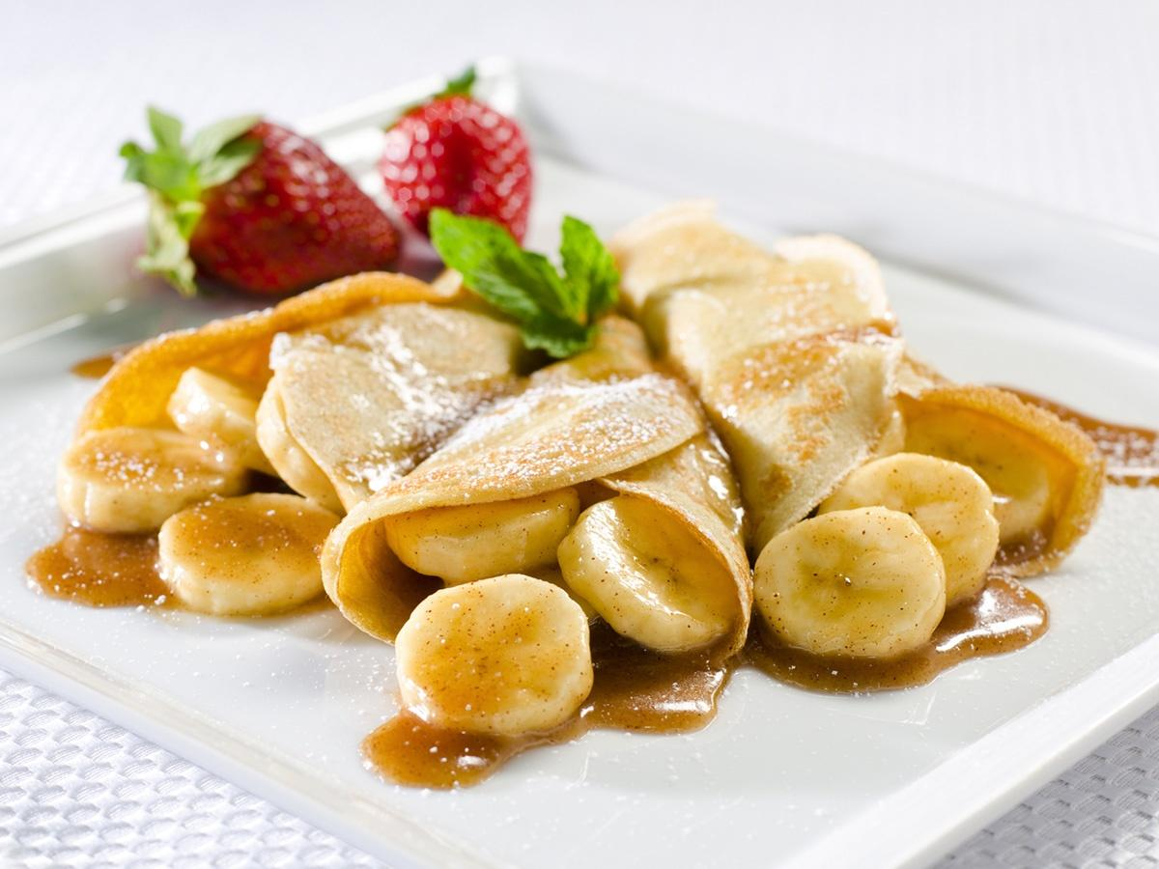
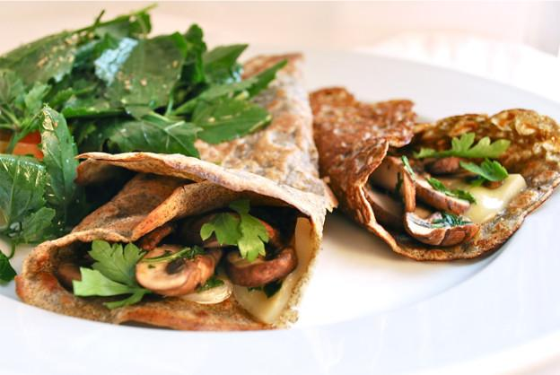
Types of Crêpes
Sweet crêpes are generally made with wheat flour, while savory crêpes are made with non-wheat flours such as buckwheat. Batters can also consist of other simple ingredients such as butter, milk, water, eggs, flour, salt, and sugar.
Common savoury fillings for crêpes served for lunch or dinner are cheese, ham, eggs, mushrooms, and various meat products. The fillings are commonly added to the center of the crêpe and served with the edges partially folded over the center.
When sweet, they can be eaten as part of breakfast or as a dessert. They can be filled and topped with various sweet toppings, often including Nutella, sugar , maple syrup, whipped cream, custard, and sliced soft fruits.

Slide 6
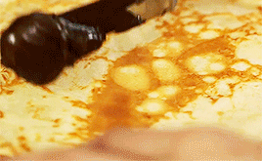
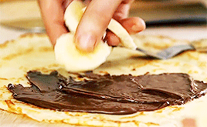
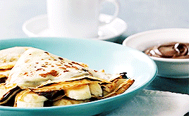
Preparation
Crêpes are made by pouring a THIN liquid batter onto a hot frying pan with a TRACE of butter on the pan's surface. The batter is spread evenly over the cooking surface of the pan either by tilting the pan or by distributing the batter with a spatula. The consistency of the batter cannot be too thick, nor can the pan be too hot. In either of these instances, the crêpe could be RUINED with lumpiness or tears. Cooking may take 30 to 60 seconds until the cooked side looks like the surface of the moon, then it is turned over to cook the other side. Because the outside of the crêpe is more attractive, they are typically never served inside out.

Slide 7
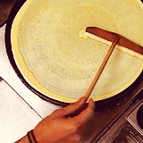
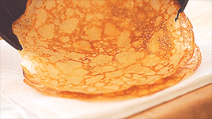
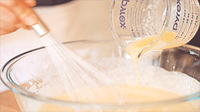
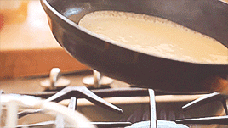
Our Journey Making Crêpes

